Slide 1
IT TICKET ANALYSIS
FOR YEAR 2016-2020
Isha jain

Slide 2
Introduction
This presentation represents IT support tickets sent between 2016 and 2020 is given in this presentation, which also highlights department-specific trends in ticket volume and resolution effectiveness.

Slide 3
What is an IT Ticket?
An IT ticket is a record of an issue, request, or problem related to IT services. It is used by IT support teams to track, manage, and resolve technical issues.
IT tickets help IT teams manage workloads, prioritize urgent issues, and improve efficiency.

Slide 4
How ticket system work?
The phases that an IT support ticket goes through from the time it is created until it is resolved or closed are referred to as the IT ticket life cycle.
IT teams can better manage and fix problems when they have a thorough understanding of the life cycle.
Having well-maintained hardware and software is crucial for a business to function effectively and boost productivity.
This is why analysis is important for a company.

Slide 5
Problem Statement
Every day, a company's IT support team deals with a large number of service tickets. These tickets reflect a variety of problems, including software and hardware malfunctions, network outages, and requests for system and login access. To increase the effectiveness of their ticket resolution procedure and learn more about the types and patterns of tickets they get, the IT team requires an analytical solution.

Slide 6
The IT Department is looking for a thorough approach for analyzing IT tickets that answers the following important questions:
Ticket Volume and Categorization: Which IT ticket types are most prevalent? What is the change of ticket volume over various periods (daily, weekly, monthly, etc.)?
Resolution Time: How long does it typically take to resolve tickets in various categories? Do some issue types routinely need more time to resolve than others?
Priority and Impact Analysis: What is the relation between ticket priority (high, medium, and low) and resolution times? Do high-priority tickets get resolved quickly?
Workload Distribution: How do members of the IT team distribute tickets? Do some team members have numerous tickets or not sufficient enough?
Client contentment: How does customer satisfaction vary by ticket type or resolution time, and what is the average rating after a resolution?

Slide 7
Objectives
Create a dashboard or analytical system to measure and assess the effectiveness of ticket resolution by: Classifying and monitoring the amount of tickets.
Identifying trends in ticket resolution time.
Analyzing how team members divide their burden.
Analyzing the variables that influence ticket resolution time and customer satisfaction.
Suggestion for Process Improvement.

Slide 8

Let's examine the dataset and comprehend the extent of our analysis of IT tickets. Which salient features of our ticket data catch your attention?

Slide 9
Data Overview
Ticket Volume:
Total tickets logged: 97000+
Time period covered:2016 To 2020.
Key Fields-Ticket ID, Date,Issue Type, Request Category, Severity Type, Priority Type, Resolution Time, Satisfaction Rate, Agent Name, Agent Email, Agent D.O.B, Agent ID etc.

Slide 10
Ticket Categorization
Breakdown of common ticket categories:
Hardware Issues: e.g., computer failures, printer malfunctions.
Software Issues: e.g., software bugs, application errors.
Login Access Requests: e.g., password resets, permission requests.
System: System performance Issues.

Slide 11
What aspects of the ticket allocation across the various categories stand out to you? Do any particular categories stick out as being especially high or low? What are some important areas where we might require more training or resources based on the categorization?

Slide 12
Key Insights
At 40%, system issues predominate, suggesting that consumers are experiencing serious performance or outage issues.
With 29.94%, Login Access comes in second, indicating recurring problems with access permissions or password resets.
Software issues account for 20.07% and are probably caused by faults or defects in applications.
At 9.98%, hardware issues are the least common, which may be due to greater maintenance or fewer device failures.

Slide 13
Ticket Volume Trends
The percentage of ID tickets has been steadily increasing, with a significant increase in 2020.
This increasing tendency can be a sign of more problems needing to be fixed or a growing need for ticket management.
Further research into the source is necessary because the sharp increase in 2020 may have been caused by particular occurrences or modifications, such as system updates or remote work.

Slide 14
“Over time, we have monitored ticket volumes. What patterns or irregularities do you notice in the data?”
“What is the relationship between these trends and known occurrences or modifications to our IT infrastructure?”

Slide 15
Resolution Time Analysis
With a minor rise in 2020, the resolution time stays largely constant. This can suggest that, particularly if ticket numbers increase, procedures or resource distribution need to be reviewed in order to retain efficiency.

Slide 16
The average resolution time by ticket type is shown on this slide. Is there anything we can learn to speed up our response times?
"Considering the information provided, do you have any recommendations for decreasing resolution time?"

Slide 17
Severity Vs Resolution Time
Concerns are categorized according to their severity: Urgent concerns are fixed the quickest, taking an average of two days.The average time to resolve minor and unclassified concerns is three days. On average, major difficulties take four days to resolve. At five days, normal concerns take the longest to resolve.
This implies that while standard and large issues take longer to resolve, more urgent issues are prioritized and handled more quickly. This could point to areas where the procedure for managing less important but still significant issues needs to be improved.

Slide 18
This is how resolution timeframes are impacted by ticket severity. Do you believe the severity system we have in place is working well?
"How can we improve efficiency by changing the way we handle high-severity tickets?"

Slide 19
Priority Vs Resolution Time
High priority issues are resolved the quickest, averaging 3 days.
Medium priority issues follow at 4 days.
Unassigned issues have an average resolution time of 5 days, indicating they might not be prioritized promptly.
Low priority issues take the longest to resolve, averaging 6 days.
This suggests that while lower priority and unassigned concerns take longer to resolve, more critical issues are handled more quickly. Overall resolution procedures may be streamlined by making sure unassigned issues are quickly sorted and by more effectively handling low-priority concerns.

Slide 20
This slide shows illustrates the effects of varying ticket priorities on resolution times. What patterns or tendencies do you see in this situation?
Think about this: Do you believe that our existing system of prioritization efficiently and promptly handles matters that are of utmost importance? Why not? Tell us about your experiences or ideas about how priority may have affected resolution time.

Slide 21
Work Load Distribution
The largest age group, those between the ages of 35 and 44, handle over half of all tickets (47.81%), making them the most active or seasoned group in ticket management.
A sizeable percentage (30.05%) is handled by people aged 25 to 34, indicating a substantial contribution from a younger, potentially more tech-savvy group.
The least quantity (22.14%) is handled by those aged 45 to 54, which may be due to their lower team representation or differing roles in comparison to younger groups.

Slide 22
Daily Average Ticket Analysis
Every year, the daily volume of tickets handled has risen steadily.
The biggest increase, of around 21 tickets each day, happens between 2019 and 2020.
This pattern points to a rise in the number of issues that need to be resolved, either as a result of organizational changes or user demands.

Slide 23
“Here we examined the daily average ticket volume over the analysis period. This helps us understand typical daily workloads and identify any patterns or fluctuations.”

Slide 24
Customer Satisfaction vs Resolution Time
When issues are resolved within 3–4 days, the greatest CSAT score (82.82%) is obtained, indicating the highest level of customer satisfaction.
A mild decline in customer satisfaction with extended resolution durations is suggested by the slight reduction in satisfaction to 78.94% after 4-5 days.
The average CSAT score for more than five days is 80.43%, which is higher than the range of three to four days but somewhat lower than the range of five to five days.

Slide 25
Insights
System and hardware issues take the longest to fix, whereas login problems take the shortest.
Long resolution times and poor satisfaction ratings may indicate that an agent needs more tools, support, or training to perform better.
Age range: 35–44This group takes the longest to resolve issues and has the lowest CSAT score. To increase their productivity and customer satisfaction, these agents could need specialized training. They might also need assistance with technology tools or workflow management to speed up resolution times.

Slide 26
Outdated systems may be the cause of some problems, such as hardware and system issues, which take longer to resolve. The IT staff will be able to work more effectively if issue is resolved, which will lower the average resolution time and raise customer satisfaction.
There has been no discernible change in the average resolution time over time, and this could be further decreased or improved.
The number of tickets sold each day has been rising over the years, with an average of 53 tickets per day.
75% of issues are IT requests, and 25% are IT error types.
The team's average resolution time is five days, rounded off.
Depending on how serious the cases are The average resolution time for urgent situations is two days.

Slide 27
Suggestions
Dedicated Support Teams: We can think about assigning agents with knowledge of hardware and system problems or creating specialist teams. This may result in shorter resolution times and more effective problem-solving.
Enhance Tools: In order to expedite the resolution of hardware and system problems, we must guarantee that agents have access to cutting-edge diagnostic tools and resources.
Distribution of Tickets: We ought to think about allocating tickets to the various age groups more fairly. Since they handle tickets promptly and with great satisfaction, the 45–54 group may take on more, while the 35–44 group could do better with a lighter workload.

Slide 28
Automation: Where feasible, we can use automation to manage repetitive hardware and system issue duties, freeing up agents to concentrate on more difficult challenges.
Performance Benchmarking: To make sure ART targets for software problems are attainable, we can review them. If present goals are regularly reached, think about establishing more difficult objectives to spur additional progress.
Hiring: We need hire additional agents because the number of tickets is growing every year.

Slide 29
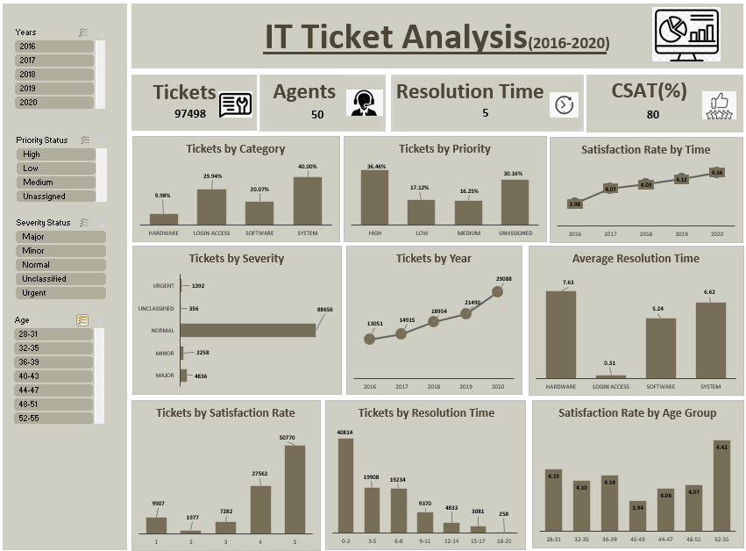
Dashboard Snapshot

Slide 30
Thank You!

